Slide 2
BRIDGE TOGETHER
WITH NATURE
İSTANBUL 2020

Slide 3
As Global Environment Organisation, we had formed our project in the name of “Bridge Together With Nature İstanbul 2020” to apply youth programs as part of Action 5.1 national meetings which had been started with the motto of “Bridge Together” generated for the Olympiads in our country.

Slide 5
With this project, our aim was to introduce our country, and support works that are done for the candidacy of Istanbul Olympiads 2020 which we care so much in terms of helping youngsters like sports.

Slide 7
Essentially, we wanted policy makers and youngsters come together for this issue and encourage them to participate in these activities directly, and we want them to share their ideas about what they can do or suggest for the youngsters’ employment with 30 billion dollar budget which is going to be used in the process of olympiads.

Slide 8
We produced policies solely with the participation of youngsters’ paying attention to the issues at the summit which were organized with the participation of educators, academicians, non-governmental organization representatives, public enterprises, and 120 youngsters from different parts of the country.

Slide 9
This summit was held between
23th -27th October in Istanbul and it will last 4 nights and 5 days. Thus, we contributed to our country’s future with the report that we are prepared at the end and shared with the policy makers.

Slide 10
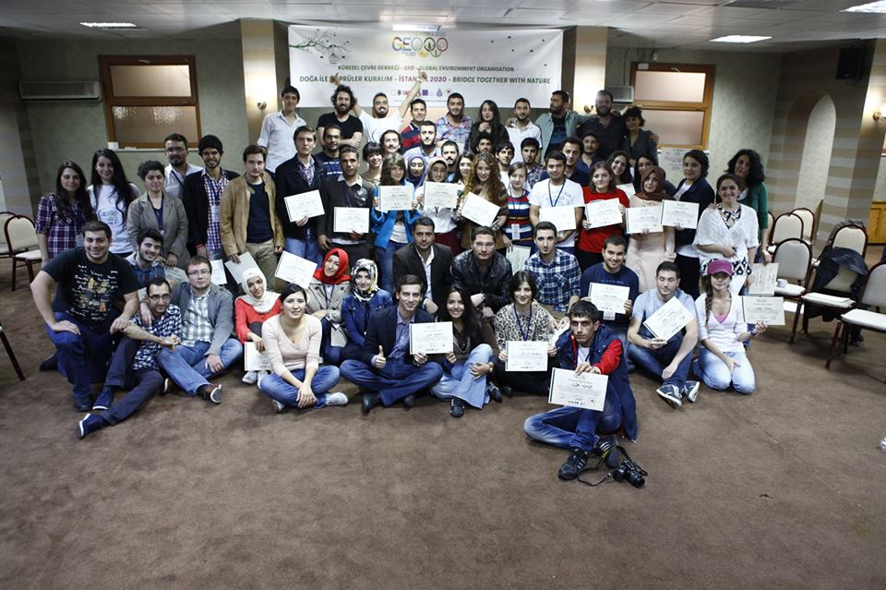

Slide 11
ENVIRONMENT AS A HUMAN RIGHT: ADVOCACY AND RIGHT BASED APPROACHES TRAINING

Slide 12
As The Universal Declaration of Human Rights (UDHR) and Stcokholm Conference fundamental rights that every individual lives better in the healty environment.

Slide 13
We have organised “ Environment as a Human Rights: Advocacy and Right Based Approaches Training” because different NGO’s representatives and indiviuals who are activist about fundamental rights of individuals from the environmental right / healthy environment who are unaware of their rights . We wanted to make them awared of their rights, to develop their capacity and share their knowledge with target group .

Slide 14
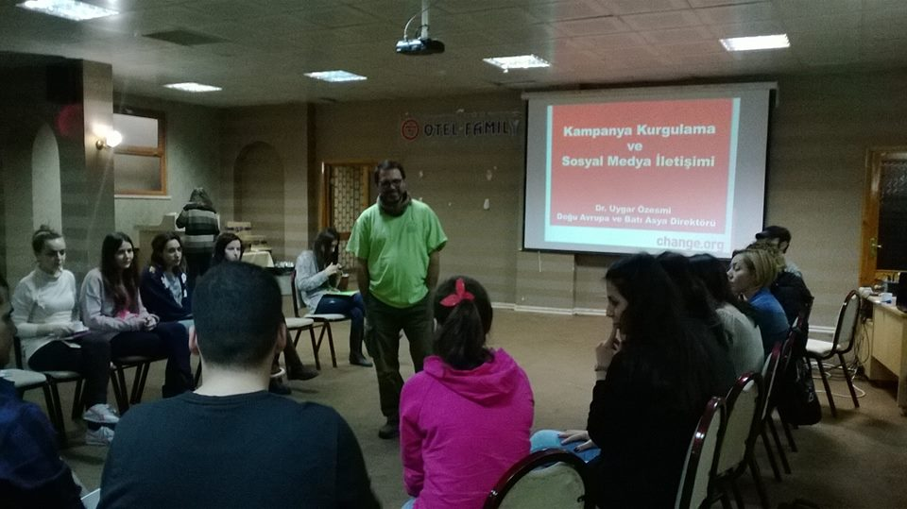

Slide 15
Environmental Rights Advocacy Training which supported by “Sivil Düşün” EU program was carried out with two group consisting of 30 persons for 2 days . The first one was in 18 to 19 February , the second one was 22 to 23 February . Eastern Europe and Western Asia Coordinator of Change.org Uygar Özesmi and Turkey's National Olympic Committee, Environmental Commission Member and lawyer Mine Izmirli attend as speakers and shared their knowledge . Participants are selected from local NGO representatives and the relevant individuals from different regions of Turkey

Slide 16
