Slide 1
Let’s make waste be in our favour!

Slide 2
Do your basket and garden look like this?

Slide 3
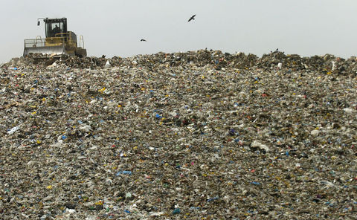
Carelessness and imprudence!

Slide 4
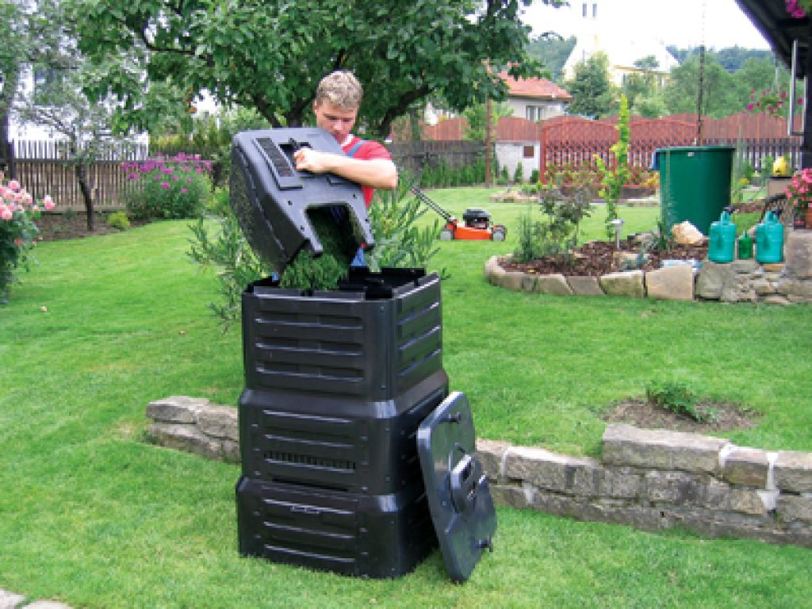
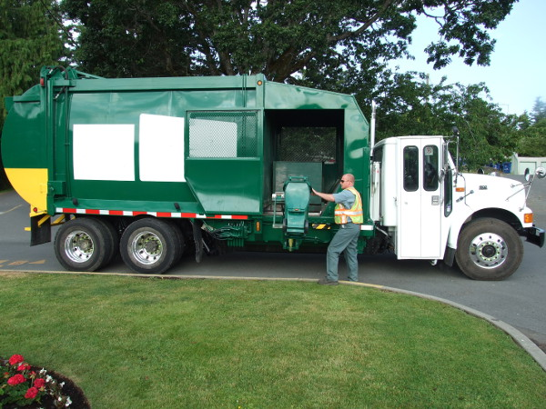

Slide 5
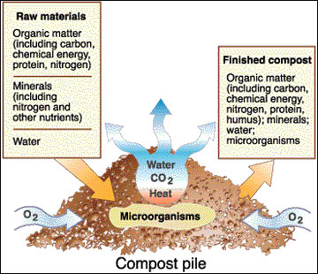
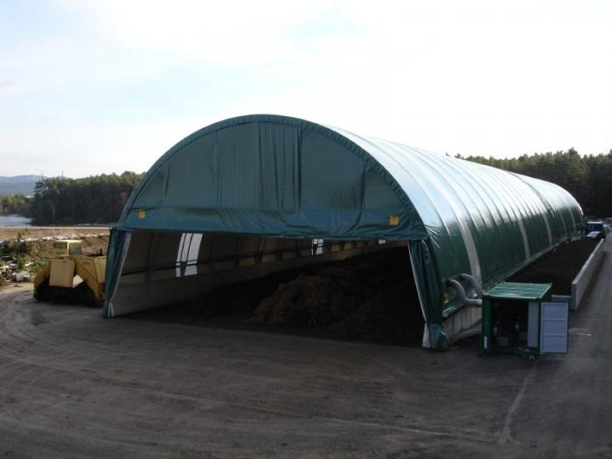
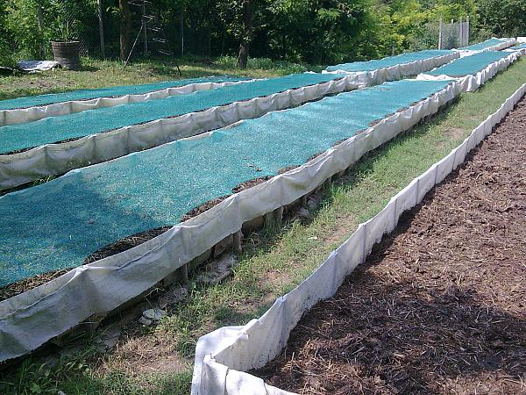

Slide 6
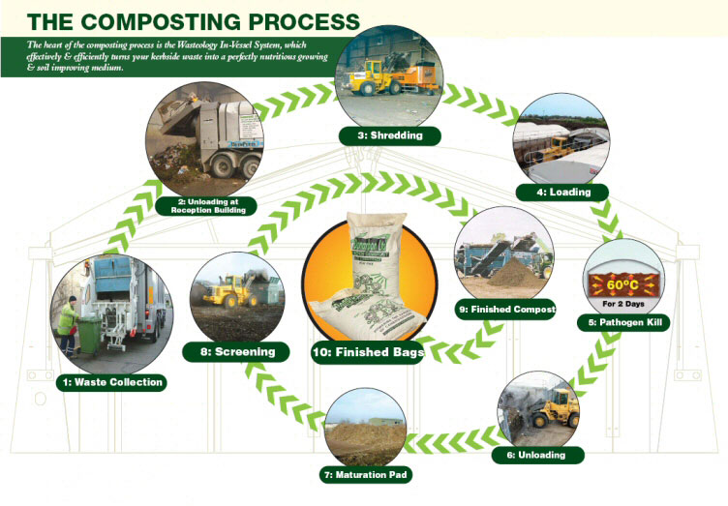

Slide 7
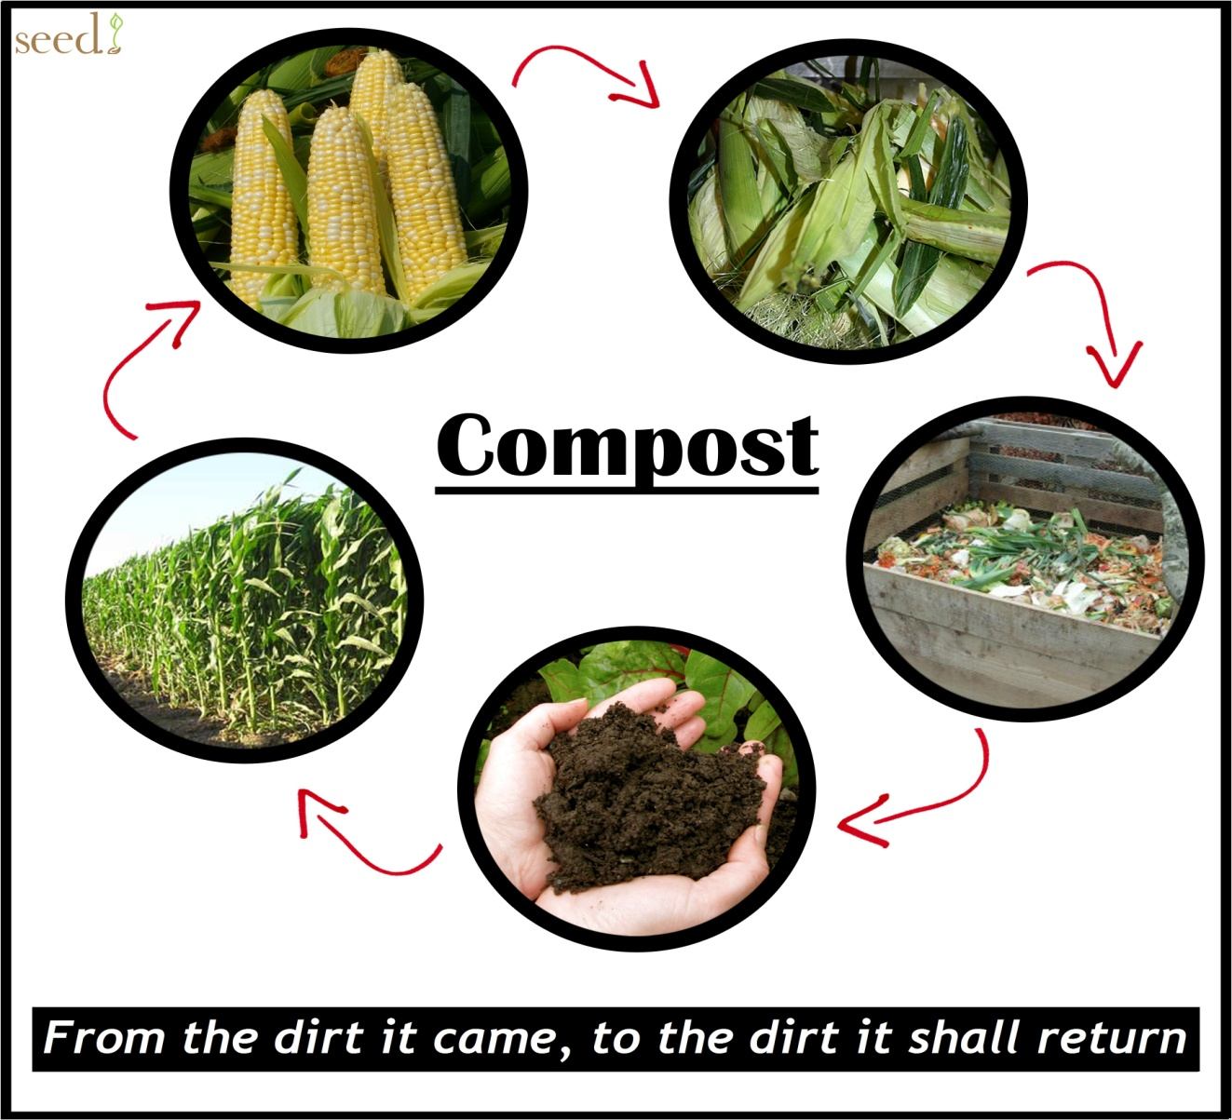
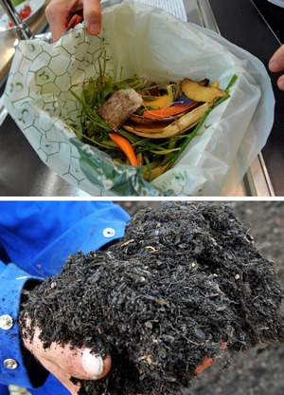

Slide 8
We can make the world be greener, brighter and more beautiful!

Slide 9
Thank you for the attention! Dafina Stoyanova Agricultural University Bulgaria

